Slide 1
#GUC19
02.02.21
Project Overview 24.02.21

Slide 2
To understand how young people are experiencing and responding to the Covid-19 crisis, and to make suggestions for how to promote young people’s wellbeing and rights during and after the pandemic.
How is the crisis affecting young people’s everyday lives and those around them, and how are they responding?
What do young people think about the attitudes, values, and behaviours of others, and the positive and negative consequences of the Covid-19 crisis for society?
What are young people’s perspectives about how the crisis is being managed, and the measures that are put in place?
To what extent are young people’s needs and circumstances being taken into account, and what is their actual and potential contribution as active citizens?
What do young people perceive as the priorities for rebuilding society, and what actions are needed to safeguard young people’s rights in the future?

Slide 3
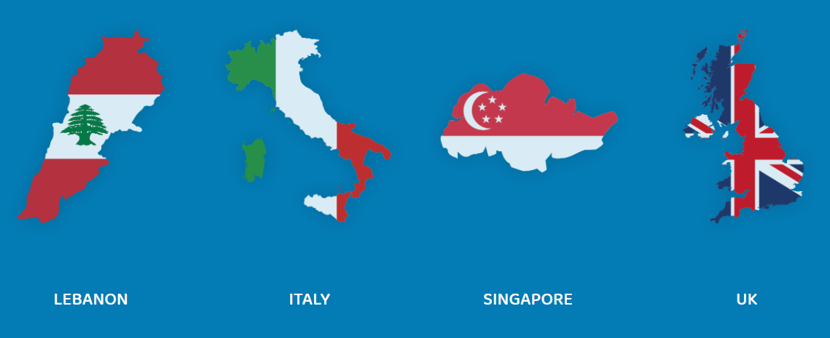
Study scope and target groups
Participant selection
Country selection
70 action researchers, ten young people per country.
14-18 year olds in diverse personal circumstances; motivation to participate.
Explicit focus on young people experiencing adversity during the crisis: LGBTQ+, BA young carers, young people with long-term medical conditions.
Seven countries: UK four nations (England, Scotland, Wales and Northern Ireland), Lebanon, Italy and Singapore. Taking into account: geography, political economy, child rights, and Covid-19 response.

Slide 4
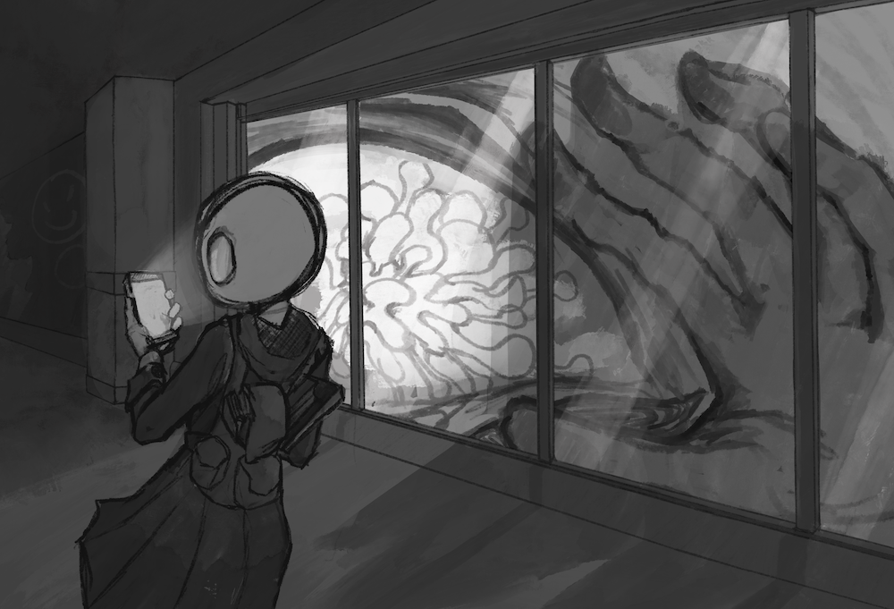
Participatory Action Research (PAR)
“An ongoing process of individuals researching their own situation, learning from experience, reflecting on the significance of this experiences with others, and using this to articulate their ideas and recommendations for future decision-making and action.”
(Percy-Smith, 2021)

Slide 5
Putting it into practice
Young people working in virtual panels, supported by an adult researcher; three cycles of PAR over 18 months.
Youth-led elements - observation, diaries, vlogs, surveys, semi-structured interviews, media and documentary analysis, conducted through:
individual action research inquiry
activities within panels / groups, and
collective dialogue between groups
Adult-led elements - one-to-one interviews, guidance and PAR toolkit.
Ongoing inter-generational collaboration – joint sense-making, analysis and interpretation.
Cycle 1:
April – Nov 2020
Covering 1st lockdown period.
Focus: establishing the research
Outputs: first published report
Cycle 2:
Dec 2020 – May 2021
Covering 2nd lockdown, vaccination.
Focus: research into action.
Outputs: reporting on group work.
Cycle 3:
June – Sept 2021
Longer term recovery planning.
Focus: final recommendations.
Outputs: final published report.

Slide 6
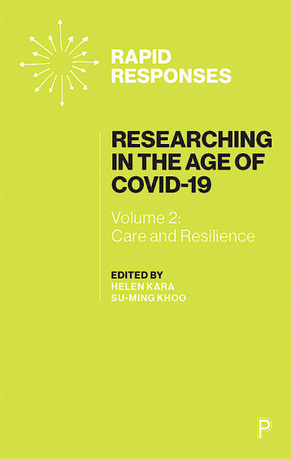
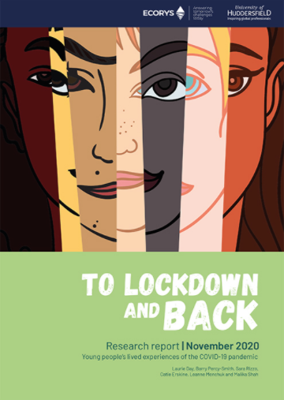
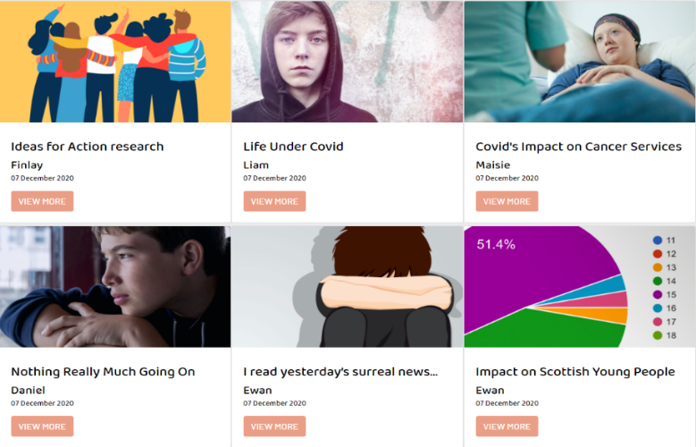
Outputs so far…

Slide 7
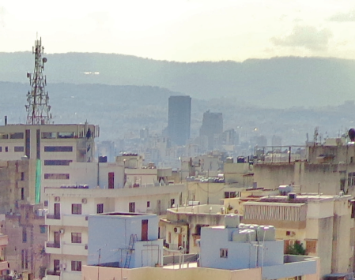
Key themes and findings 1
Mixed emotions and outcomes – a sense of anger and frustration at the social injustices that played out through the Covid-19 pandemic, and in the shortcomings in how the crisis was handled globally and nationally. But also unexpected positives: self-awareness and self-care, closeness with family members, and re-awakened social and political engagement.
Polarising effects of the COVID-19 crisis – what for some was a period of self-reflection and re-connecting, was isolating and traumatic for others. For young people with pre-existing mental health problems, trauma, facing stigma (e.g. LGBTQ+) and / or family conflict, the lockdown was immensely challenging and exacerbated the issues they faced.
Untapped potential of social media and online platforms – maintaining contact with peers and family, initiating new networks and friendship groups, triangulating news and information about the pandemic and global events, and taking social action. But with a cautionary note regarding heightened exposure to online risks and harms during this period.

Slide 8
Key themes and findings 2
System shocks and capacity - while young people understood the need to deprioritise routine professional contacts during a public health emergency, the pace and scale of social distancing measures left many cut-off from support. The shift online had mixed success. Young people identified a common priority to scale-up mental health support, post-Covid.
Education at the epicentre - irrespective of national education systems, young people understood and valued their right to education and were in tune with decisions affecting their future. They saw first-hand where disadvantaged students had fallen behind. Mixed experiences of online learning; young people wanted leadership and creativity from schools.
Crises of professional accountability? - the interviews painted a very mixed picture of professional behaviours at a time of crisis. Young people recalled where teachers, social workers and counsellors had been resourceful and adaptive, finding ways to maintain one-to-one engagement. Too often, however this fell short of expectations, with no recourse.

Slide 9
Key themes and findings 3
Disconnect between media portrayals and lived experiences – young people felt a sense of injustice at the ‘victims and villains’ narrative, from school closures to subsequent coverage of parties and dissent (UK); to erasure from mainstream news coverage (Italy). Many had turned away from mainstream news, to vloggers and the alternative press.
A desire for real partnership and collaboration with adults – young people wanted evidence that their Governments had a longer-term plan for recovery, and that they were part of this process. They called for more sophisticated and diverse modes of engagement, including for vulnerable youth, while mobilising on their own terms through direct action.
Restoring confidence in democratic processes and tackling systemic inequalities – the research underlined how far fundamental rights have been marginalised within the responses to the pandemic, and the urgent need for political leaders to stop and listen, to engage in dialogue and to be open to learning from the lived realities of different groups.

Slide 10
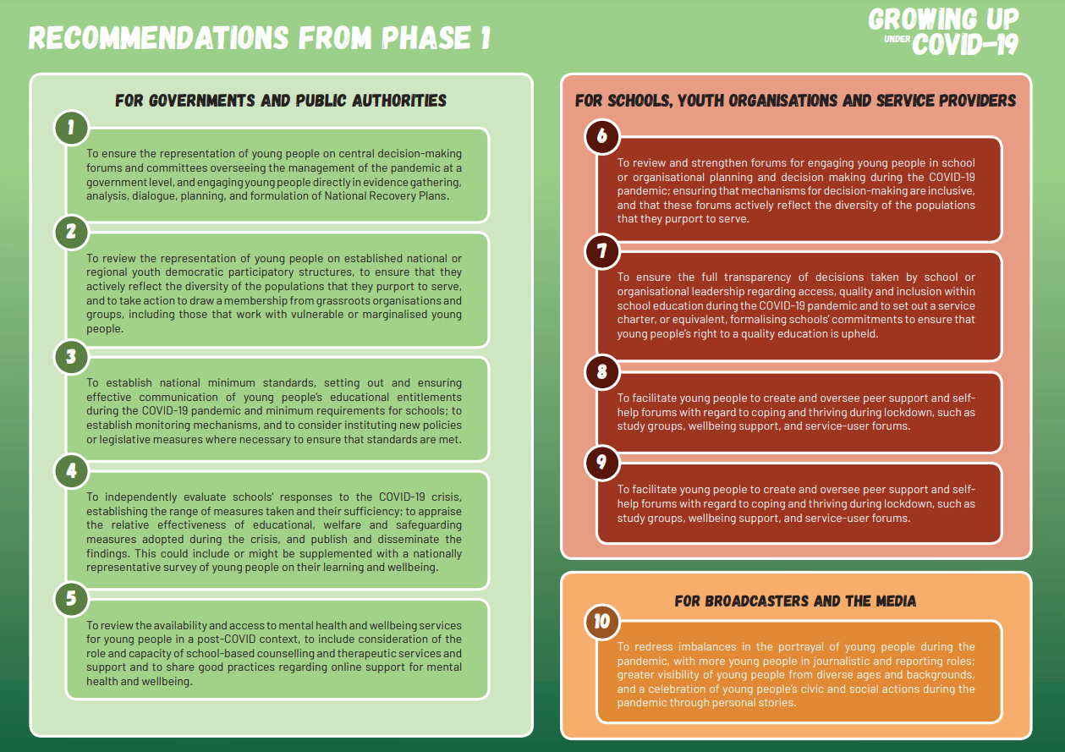
Website:
www.guc19.com
Contact us:
actionres@ecorys.com
Social media:
#GUC19

